Slide 1
Chapter 8: Main Memory

Slide 2
Fragmentation (Cont.)
Reduce external fragmentation by compaction
Shuffle memory contents to place all free memory together in one large block
Compaction is possible only if relocation is dynamic, and is done at execution time
I/O problem
Latch job in memory while it is involved in I/O
Do I/O only into OS buffers

Slide 3
Fragmentation (Cont.)
A possible solution to the external-fragmentation problem is to permit the logical address space of the processes to be noncontiguous.
Allow a process to be allocated physical memory wherever such memory is available.
Two techniques achieve this solution:
Segmentation
Paging

Slide 4
Segmentation
Memory-management scheme that supports user view of memory
A program is a collection of segments
A segment is a logical unit such as:
main program
procedure
function
method
object
local variables, global variables
common block
stack
symbol table
arrays

Slide 5
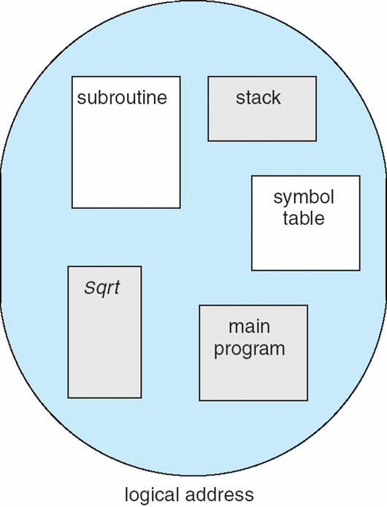
User’s View of a Program

Slide 6
Logical View of Segmentation
1
1
4
2
3
4
2
3
user space
physical memory space

Slide 7
Segmentation Architecture
Logical address consists of a two tuple:
<segment-number, offset>,
Segment table – maps two-dimensional physical addresses; each table entry has:
base – contains the starting physical address where the segments reside in memory
limit – specifies the length of the segment
Segment-table base register (STBR) points to the segment table’s location in memory
Segment-table length register (STLR) indicates number of segments used by a program;
segment number s is legal if s < STLR

Slide 8
Segmentation Architecture (Cont.)
Protection
With each entry in segment table associate:
validation bit = 0 ⇒ illegal segment
read/write/execute privileges
Protection bits associated with segments; code sharing occurs at segment level
Since segments vary in length, memory allocation is a dynamic storage-allocation problem
A segmentation example is shown in the following diagram

Slide 9
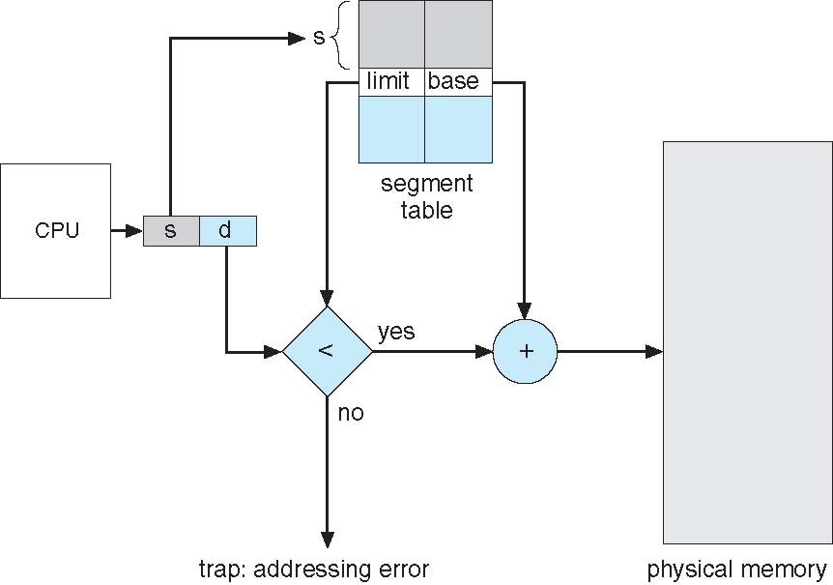
Segmentation Hardware

Slide 10
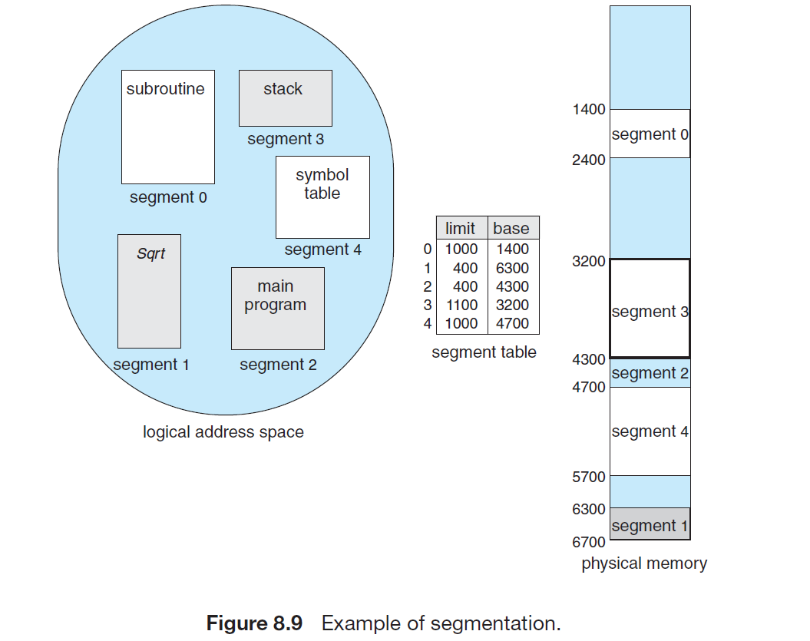
Segmentation Example

Slide 11
Paging
Physical address space of a process can be noncontiguous; process is allocated physical memory whenever the latter is available
Avoids external fragmentation
Avoids problem of varying sized memory chunks
Divide physical memory into fixed-sized blocks called frames
Size is power of 2, between 512 bytes and 16 Mbytes
Divide logical memory into blocks of same size called pages

Slide 12
Paging (Cont.)
Keep track of all free frames
To run a program of size N pages, need to find N free frames and load program
Set up a page table to translate logical to physical addresses
Backing store likewise split into pages
Still have Internal fragmentation

Slide 13
Address Translation Scheme
Address generated by CPU is divided into:
Page number (p) – used as an index into a page table which contains base address of each page in physical memory
Page offset (d) – combined with base address to define the physical memory address that is sent to the memory unit
For given logical address space 2^{m} and page size 2^{n}
The number of pages are 2 ^{m-n}

Slide 14
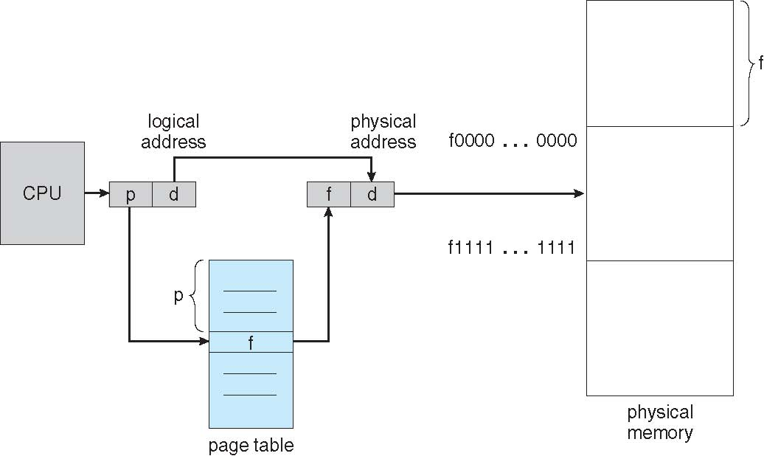
Paging Hardware

Slide 15
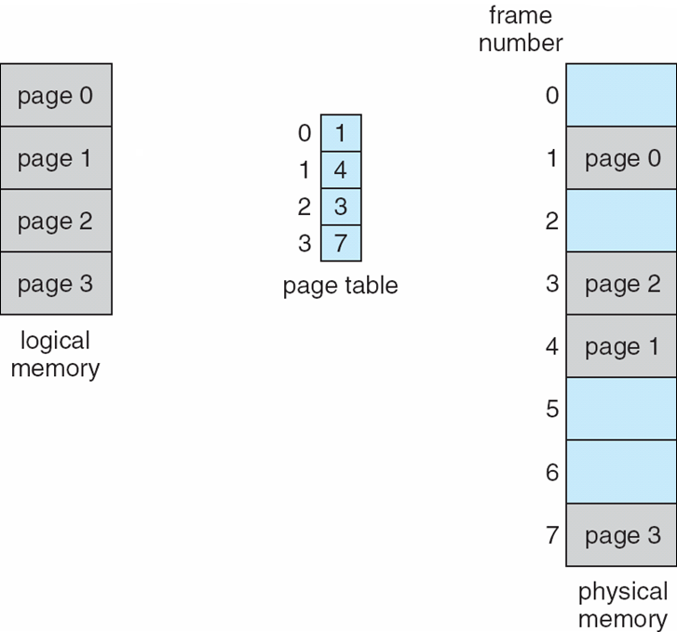
Paging Model of Logical and Physical Memory

Slide 16
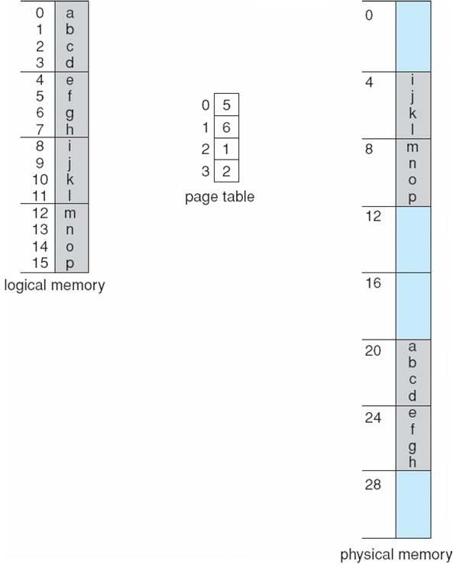
Paging Example
Physical address= (frame no * page size) + offset
If n=2 , m=4, and we have 32-byte memory and 4-byte pages
Logical address 0, (at offset 0 and page 0 ) is in frame 5 → So logical address 0 mapped into physical address 20= [(5*4)+0]
Logical address 3, (at offset 3, and page 0) is in frame 5 → logical address 3 mapped into physical address 23= [(5*4)+3]
Logical address 4, (at offset 0, and page 1) is in frame 6 → logical address 4 mapped into physical address 24= [(6*4)+0]

Slide 17
Paging (Cont.)
Calculating internal fragmentation
Page size = 2,048 bytes
Process size = 72,766 bytes
35 pages + 1,086 bytes
Internal fragmentation of 2,048 - 1,086 = 962 bytes
Worst case fragmentation = 1 frame – 1 byte
On average fragmentation = 1 / 2 frame size
So small frame sizes desirable?
However, overhead is involved in each page-table entry, and this overhead is reduced as the size of the pages increases
Page sizes growing over time
Solaris supports two page sizes – 8 KB and 4 MB

Slide 18
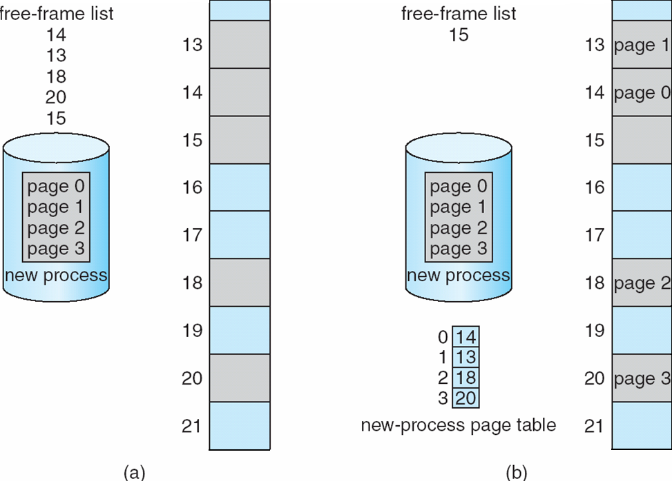
Free Frames
When a process arrives in the system to be executed, its size, expressed in pages, is examined. Each page of the process needs one frame.
if the process requires n pages, at least n frames must be available in memory
If n frames are available, they are allocated to this arriving process.
The first page of the process is loaded into one of the allocated frames, and the frame number is put in the page table for this process. The next page is loaded into another frame, its frame number is put into the page table, and so on
After allocation
Before allocation
Notes:
When a process arrives in the system to be executed, its size, expressed
in pages, is examined. Each page of the process needs one frame. Thus, if the
process requires n pages, at least n frames must be available in memory. If n
frames are available, they are allocated to this arriving process. The first page
of the process is loaded into one of the allocated frames, and the frame number
is put in the page table for this process. The next page is loaded into another
frame, its frame number is put into the page table, and so on (Figure 8.13).

Slide 19
Implementation of Page Table
Page table is kept in main memory
Page-table base register (PTBR) points to the page table
Page-table length register (PTLR) indicates size of the page table
In this scheme every data/instruction access requires two memory accesses
One for the page table and one for the data / instruction
The two memory access problem can be solved by the use of a special fast-lookup hardware cache called associative memory or translation look-aside buffers (TLBs)

Slide 20
Implementation of Page Table (Cont.)
TLBs typically small (64 to 1,024 entries)
On a TLB miss, value is loaded into the TLB for faster access next time
If the TLB is already full of entries, an existing entry must be selected for replacement
Replacement policies must be considered (like round robin and LRU)
Some entries can be wired down (meaning they cannot be removed)
Notes:
a TLB lookup in modern hardware is part of the instruction pipeline, essentially adding no
performance penalty. To be able to execute the search within a pipeline step,
however,
The TLB is used with page tables in the following way. The TLB contains only a few of the page-table entries. When a logical address is generated by the
CPU, its page number is presented to the TLB. If the page number is found, its frame number is immediately available and is used to access memory. As just
mentioned, these steps are executed as part of the instruction pipeline within the CPU, adding no performance penalty compared with a system that does
not implement paging.

Slide 21
Associative Memory
Associative memory – parallel search
Address translation (p, d)
If p is in associative register, get frame # out
Otherwise get frame # from page table in memory

Slide 22
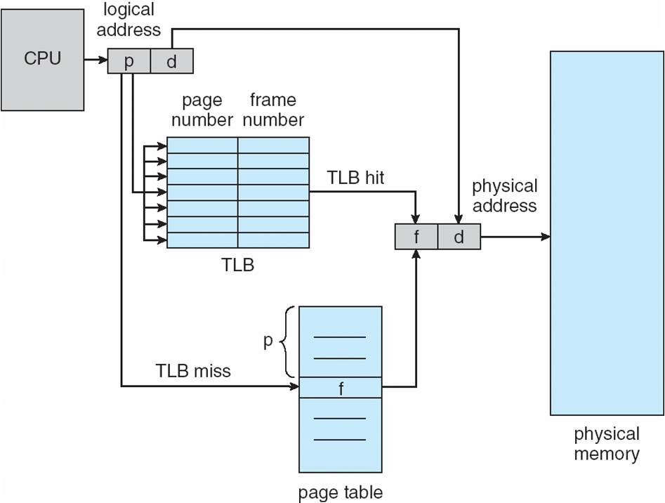
Paging Hardware With TLB

Slide 23
Effective Access Time
Associative Lookup = ε time unit
Can be < 10% of memory access time
Hit ratio = α
Hit ratio – percentage of times that a page number is found in the associative registers; ratio related to number of associative registers
Consider α = 80%, ε = 20ns for TLB search, 100ns for memory access time(MAT)
Effective Access Time (EAT)= α *MAT + (1- α )*(2*MAT)
Consider α = 80%, ε = 20ns for TLB search, 100ns for memory access
EAT = 0.80 x 100 + 0.20 x 200 = 120ns
Consider more realistic hit ratio -> α = 99%, ε = 20ns for TLB search, 100ns for memory access
EAT = 0.99 x 100 + 0.01 x 200 = 101ns

Slide 24
Memory Protection
Memory protection implemented by associating protection bit with each frame to indicate if read-only or read-write access is allowed
Can also add more bits to indicate page execute-only, and so on
Valid-invalid bit attached to each entry in the page table:
“valid” indicates that the associated page is in the process’ logical address space, and is thus a legal page
“invalid” indicates that the page is not in the process’ logical address space
Or use page-table length register (PTLR)
Any violations result in a trap to the kernel

Slide 25
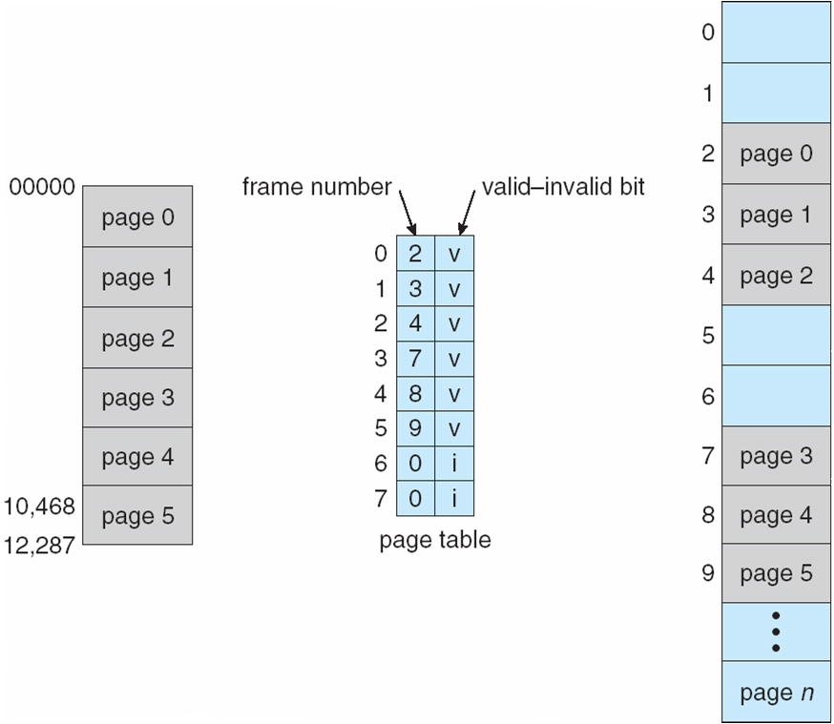
Valid (v) or Invalid (i) Bit In A Page Table

Slide 26
Shared Pages
Shared code
One copy of read-only (reentrant) code shared among processes (i.e., text editors, compilers, window systems)
Also useful for interprocess communication if sharing of read-write pages is allowed
Private code and data
Each process keeps a separate copy of the code and data
The pages for the private code and data can appear anywhere in the logical address space

Slide 27
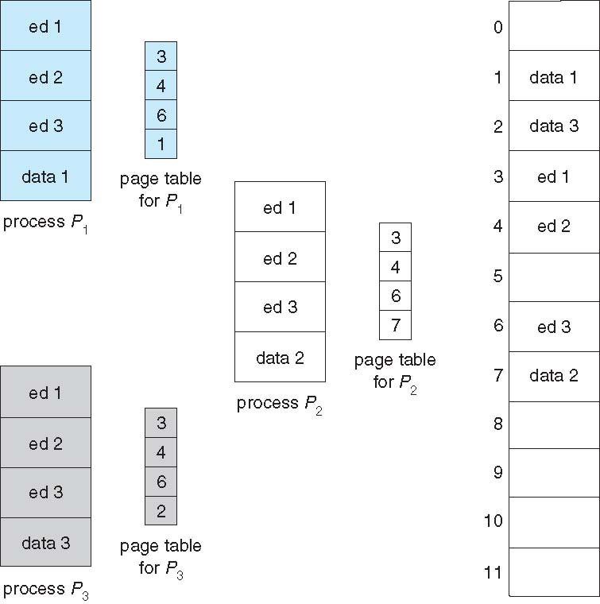
Shared Pages Example

